Slide 1
Merry Maids Sales
data Analysis AND MODELING
Lakshmi Sravya Vedantham (002989684)
Manjot Singh (002981052)
Rishabh S Thomas (002195467)
Instructor - Mathew Goodwin
ALY6080 - Integrated Experiential Learning
July 2nd, 2021

Slide 2
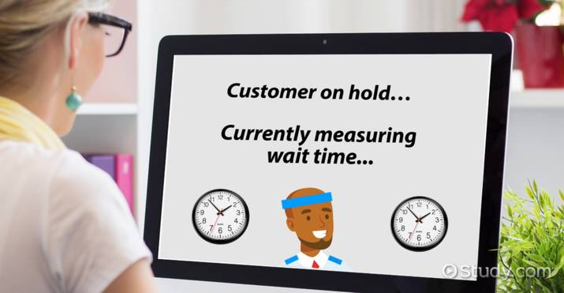
Business Problem
Merry Maids is a top service provider, but owing to a lack of an eCommerce platform, it takes about 30 minutes to close a contract with a customer by phone or in person contact. This results in the loss of recurring clients and, as a result, recurring sales.
.

Slide 3

Business Solution
Prioritizing repeat consumers during the phone conversation may result in more recurring purchases

Slide 4

Data Visualizations

Slide 5
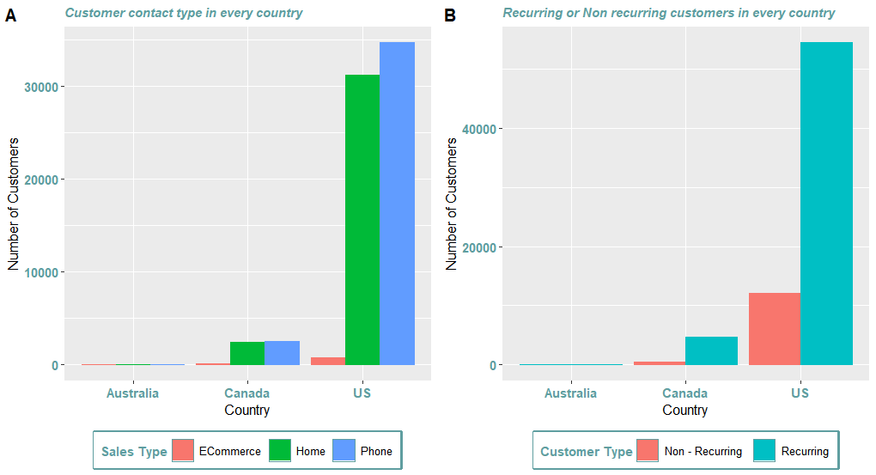
Customer Statistics in each country
The US has the majority of the customers
All the countries have more recurring customers, hence more chances of recurring sales
Most of the Customers prefer calling (Home, mobile)
We need to prioritize the calls in the US and Canada for better recurring sales

Slide 6
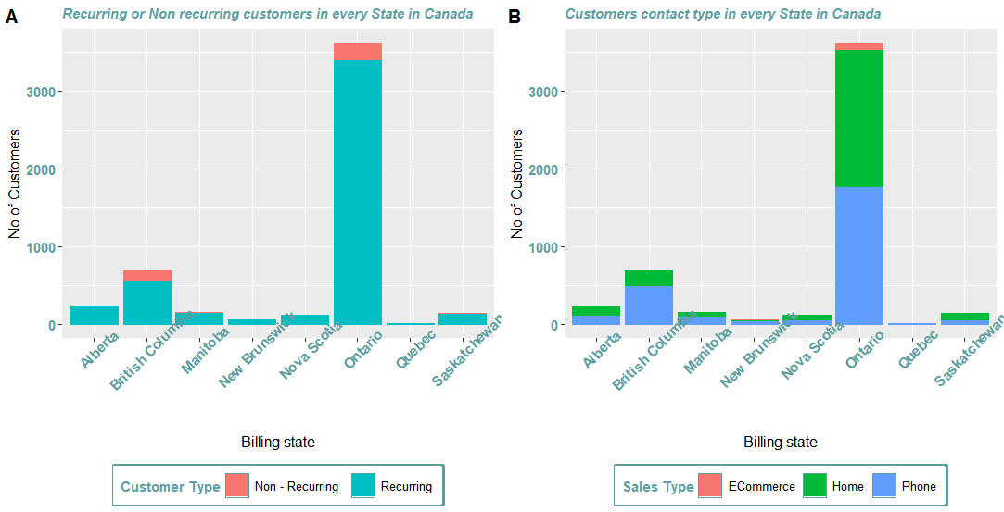
Customer Statistics in every province in Canada
The Ontario province has more customers and Quebec the least
More recurring customers are there over nonrecurring customers
Most of the customers prefer Home and Phone for contacting

Slide 7
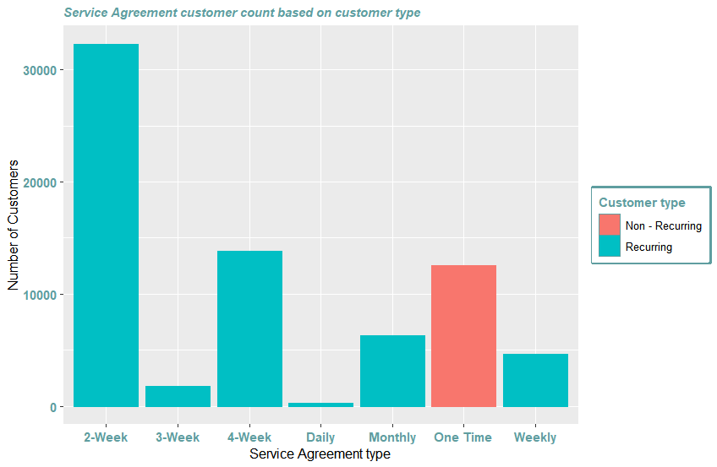
Service Agreement Statistics in every country
The Service agreement is of 7 categories
Bi-weekly is a majorly used service (around 30000+ customers) all over the countries and daily service the least.
All nonrecurring customers belong to one time service agreement

Slide 8
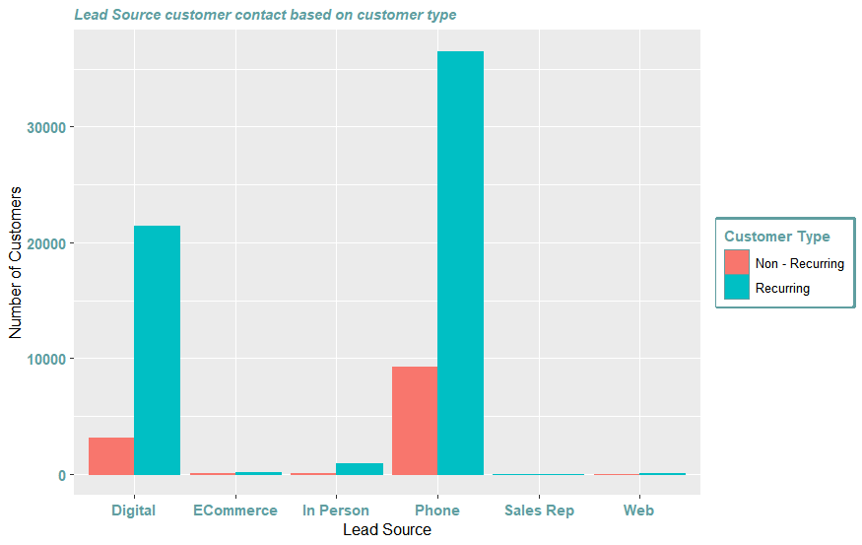
Lead Source Statistics
Customer Contact is mostly through 6 lead sources
Phone and Digital are the major lead sources of communication .
Hence priority should be given to calls and digital media for more recurring sales

Slide 9
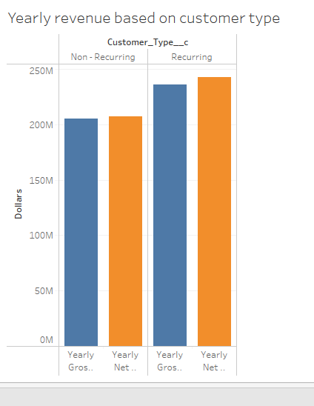

Customer type vs Yearly revenue
Yearly gross and yearly net for recurring customers is higher than nonrecurring customers
It is found to be around 250 Million dollars revenue yearly through recurring customers
There is almost 50 Million dollars in difference based on the customer

Slide 10
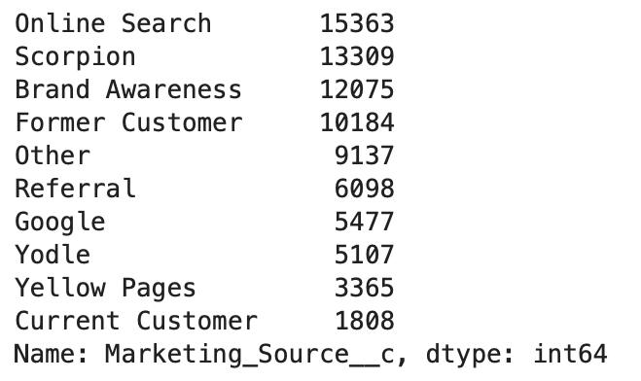
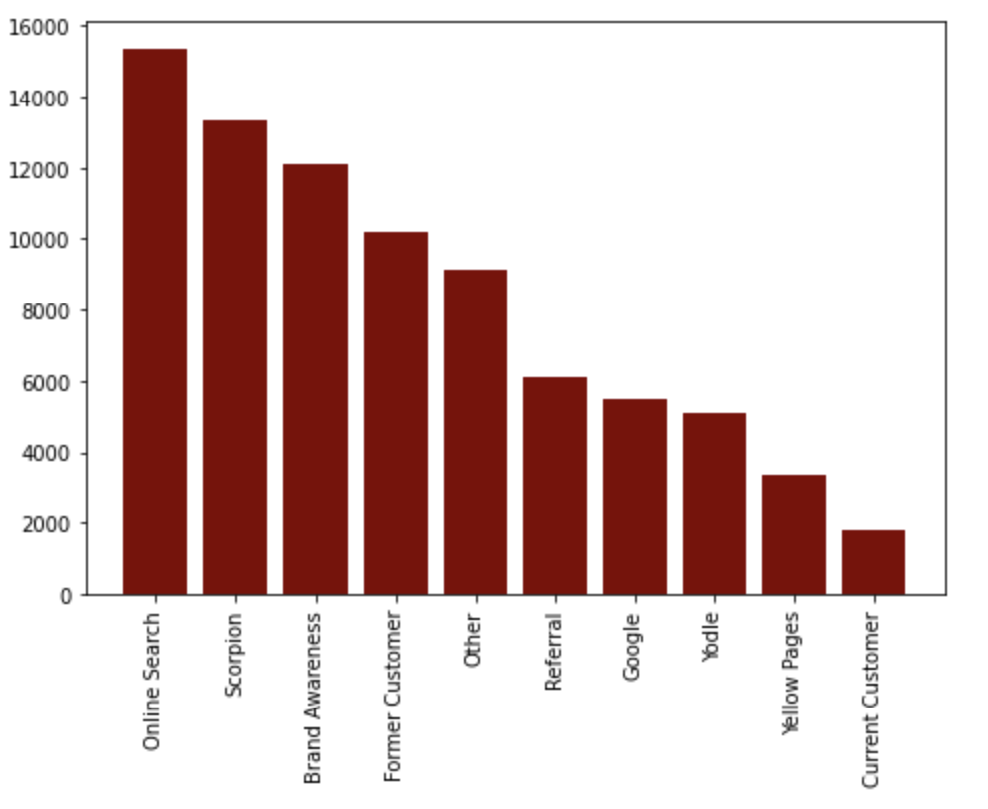
Top 10 Marketing Sources and their frequencies

Slide 11
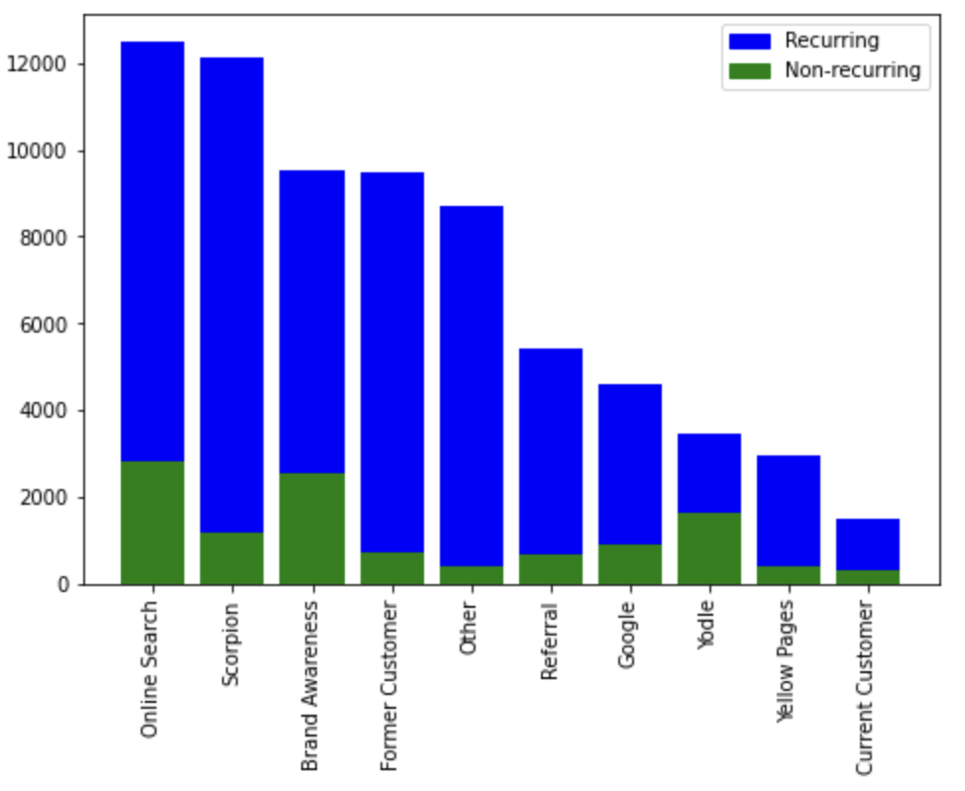
Top 10 Marketing Sources distribution between recurring and non-recurring customers
As we can see from the plot for Recurring ring customers sources like "Scorpion", "Referral", "Google Search" and "Yellow Pages" are much more frequent and relevant.
While sources such as "Online Search" and "Brand Awareness" are almost the same for both types of customers.
This tells us that sources such as "Scorpion" helps bring recurring customers more than non-recurring customers.

Slide 12

Data Modelling

Slide 13
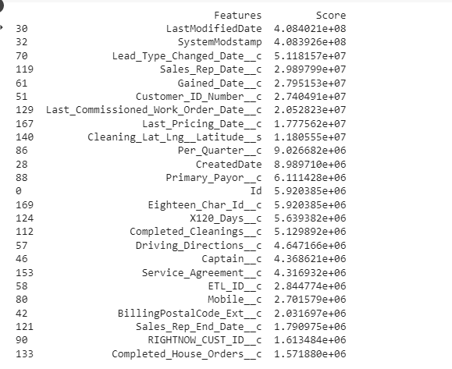
Feature Selection
It's challenging to deal with 184 characteristics.
For future study, the best features are chosen depending on the score.
After transforming using a label encoder, the top 25 features are chosen using feature selection package of Sklearn
Brownlee, J. (2020, August 28). Feature Selection For Machine Learning in Python. Machine Learning Mastery. https://machinelearningmastery.com/feature-selection-machine-learning-python/

Slide 14
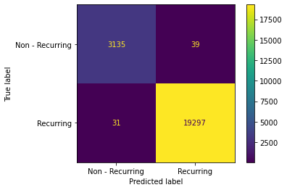
Logistic Regression
Logistic regression is used to classify the recurring and nonrecurring customers based on the top 25 features selected features
Gives accuracy score, precision score, and recall score of 99.6% for the given dataset
If mobile, customer ID is fed into the logistic model, it gives the almost correct prediction

Slide 15
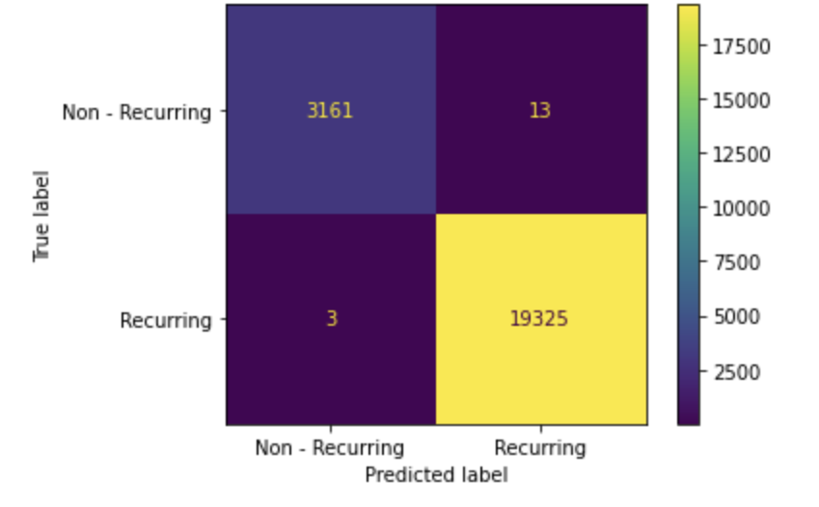
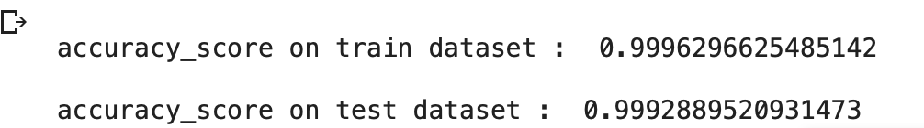
XG Boost
XGBoost is an ensemble learning method. Bagging and boosting are two widely used ensemble learners that is used in XGBoost
Though these two techniques can be used with various statistical models, the most predominant usage has been with decision trees.
Unique features of XGboost is that it helps in regularization and penalize missing data.
T., B. (2022, January 7). Beginner’s Guide to XGBoost for Classification Problems | Towards Data Science. Medium. https://towardsdatascience.com/beginners-guide-to-xgboost-for-classification-problems-50f75aac5390

Slide 16
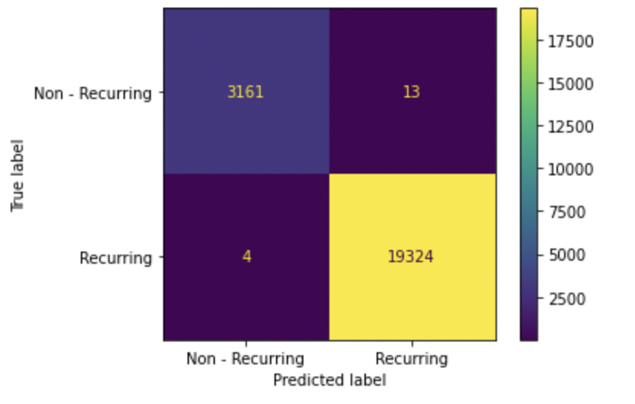
Random Forest
A random forest is a supervised machine learning algorithm that is constructed from multiple decision tree algorithms.
It predicts by taking the average or mean of the output from various trees. Increasing the number of trees increases the precision of the outcome.
It’s more accurate than the decision tree algorithm as it solves the major problem that is overfitting.
In our case accuracy comes out to be 0.999 for test data set and 1.0 for training set which shows that there is no overfitting.

Slide 17
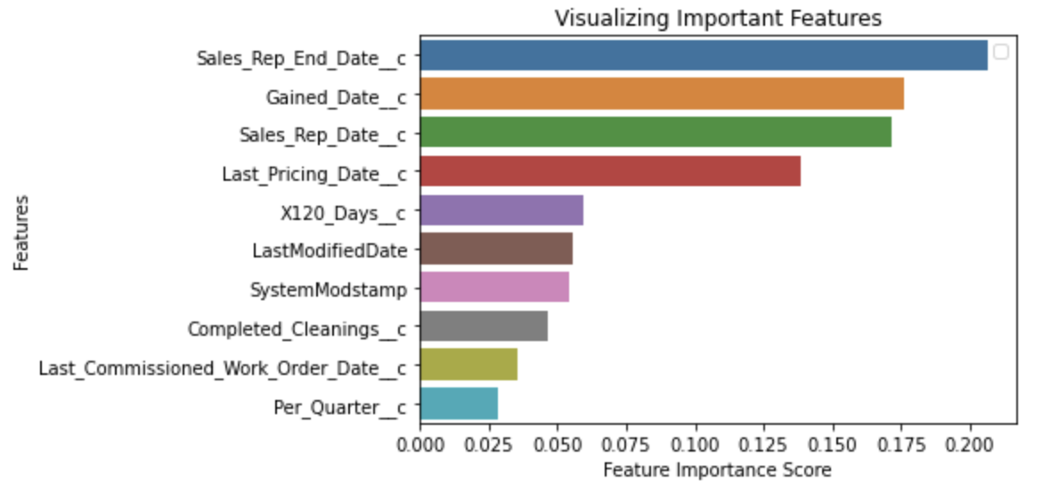
Top 10 important features
The Feature importance is calculated as the number of nodes split at each feature in a random forest classifier.
As we can see, sales res dates contributes the most while prediction of customers.

Slide 18

Decision Trees
Decision Trees is used to classify the recurring and nonrecurring customers based on the top 25 features selected features​
Gives accuracy score, precision score, and recall score of 99.9% for the given dataset​
If mobile, customer ID is fed into the decision trees model, it gives the almost correct prediction ​
DataCamp. (n.d.). Python Decision Tree Classification Tutorial: Scikit-Learn DecisionTreeClassifier. Datacamp. Retrieved June 18, 2022, from https://www.datacamp.com/tutorial/decision-tree-classification-python

Slide 19
Comparison
Models | Accuracy (%) | F1-Score(%) | Precision Score (%)
Logistic Regression | 99.6 | 99.6 | 99.6
Random Forest | 99.99 | 1.0 | 1.0
Decision Trees | 99.9 | 99.9 | 99.9
XG Boost | 99.96 | 99.9 | 99.9
From the above comparisons, we can conclude that random forest can be best fitted model for the classification for this given dataset

Slide 20
Recommendations & Findings
Because the majority of consumers are in the United States, it is necessary to prioritize calls in the United States and Canada to increase recurring purchases.
Customers' primary means of communication are the phones, thus they should be prioritized.
The difference in annual revenue between recurrent and nonrecurring clients is about $50 million.
Finally, Marketing sources such as "Scorpion" and "Referral" are adding much more value for recurring customers than non-recurring customers.
All these rules-based evidence helped us to figure out that tree-based classification models will work better for our business objective (Recurring or Non-Recurring)
The top 25 features are chosen and employed in logistic regression modeling, random forest, decision trees, and XGboost models resulting in a 99.6% to 100% accuracy, f1 score, and precision scores
We concluded that random forest can be best-fitted model for the classification of this given dataset

Slide 21
FAILED TECHNIQUES
These ML models do not operate as intended when all features are included in the model.
When these models were tested with various features, those that weren't the best produced poor results
The best attributes for the models are not stated in the correlation graphic.
As our baseline model we tried using Naïve Bayes but turned out our data set wasn't fulfilling the assumptions of naïve bayes such as the distribution of the data should be gaussian and all the features must be independent of each other which is not the case.
Including all features was overfitting our model as there was a huge difference between training and test accuracy so we took into consideration the top 25 features which were contributing the most in the predictions.

Slide 22
Improvements
Can develop additional promotions for loyal clients and draw in new ones
A significant fraction of callers are unable to interact during calls because of a language barrier; not all clients can speak English. As a result, the model may include a language option that would allow the call to be routed to a French speaker for French customers or another language for everyone else.
We can add a feedback system in our model for misclassified observations. All the incorrect predictions weightage is increased and model is trained again on monthly basis so that our model accuracy keeps on improving over time.
We can implement several reward and referral campaigns for recurring customers in order to bring in more loyal customers and improve the conversion rate.

Slide 23
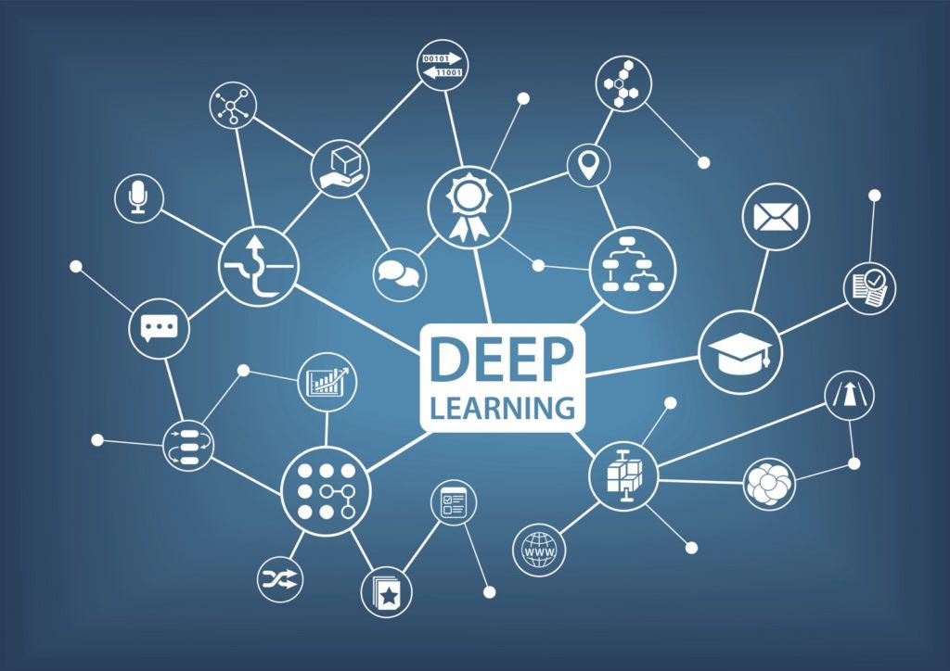
Future Research
We have just explored the data so far. We would like to dig deeper and try to tune and model and finalize the best model with less performance time. We would also try to work on voting classifier and deep learning models in the future.

Slide 24
References
Side-by-side plots with ggplot2. (2009, August 8). Stack Overflow. https://stackoverflow.com/questions/1249548/side-by-side-plots-with-ggplot2
Brownlee, J. (2020, August 28). Feature Selection For Machine Learning in Python. Machine Learning Mastery. https://machinelearningmastery.com/feature-selection-machine-learning-python/
Facing ValueError: Target is multiclass but average=’binary’. (2018, September 11). Stack Overflow. https://stackoverflow.com/questions/52269187/facing-valueerror-target-is-multiclass-but-average-binary
SciKit-Learn Label Encoder resulting in error “argument must be a string or number.” (2019, November 14). Stack Overflow. https://stackoverflow.com/questions/58868256/scikit-learn-label-encoder-resulting-in-error-argument-must-be-a-string-or-numb
DataCamp. (n.d.). Python Decision Tree Classification Tutorial: Scikit-Learn DecisionTreeClassifier. Datacamp. Retrieved June 18, 2022, from https://www.datacamp.com/tutorial/decision-tree-classification-python
Gould, D. (2021, April 7). Beginner's Guide to XGBoost for Classification Problems. Towards Data Science. Retrieved June 19, 2022, from
T., B. (2022, January 7). Beginner’s Guide to XGBoost for Classification Problems | Towards Data Science. Medium. https://towardsdatascience.com/beginners-guide-to-xgboost-for-classification-problems-50f75aac5390
Feedback loop in Machine Learning – Labeling data. (2019, September 24). LinkedIn. Retrieved July 2, 2022, from https://www.linkedin.com/pulse/feedback-loop-machine-learning-labeling-data-sanchit-tiwari/

Slide 25

Thank You

